Slide 1
Flow of Control: Loops
Chapter 4

Slide 2
Objectives
Design a loop
Use while, do, and for in a program
Use the for-each with enumerations
Use assertion checks
Use repetition in a graphics program
Use drawString to display text in a graphics program

Slide 3
Java Loop Statements: Outline
The while statement
The do-while statement
The for Statement

Slide 4
Java Loop Statements
A portion of a program that repeats a statement or a group of statements is called a loop.
The statement or group of statements to be repeated is called the body of the loop.
A loop could be used to compute grades for each student in a class.
There must be a means of exiting the loop.

Slide 5
The while Statement
Also called a while loop
A while statement repeats while a controlling boolean expression remains true
The loop body typically contains an action that ultimately causes the controlling boolean expression to become false.

Slide 6
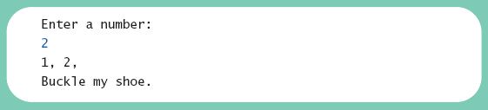
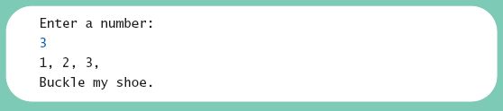
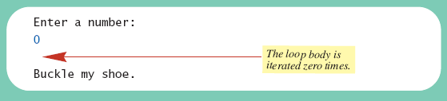
The while Statement
View sample program, Listing 4.1
class WhileDemo
Sample
screen output

Slide 7
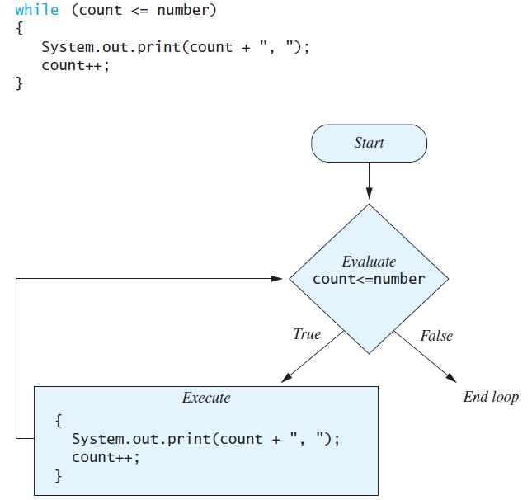
The while Statement
Figure 4.1
The action of the while loop in Listing 4.1

Slide 8
The while Statement
Syntax
  while (Boolean_Expression)
  Body_Statement
  or
  while (Boolean_Expression)
  {
  First_Statement
  Second_Statement
  …
  }

Slide 9
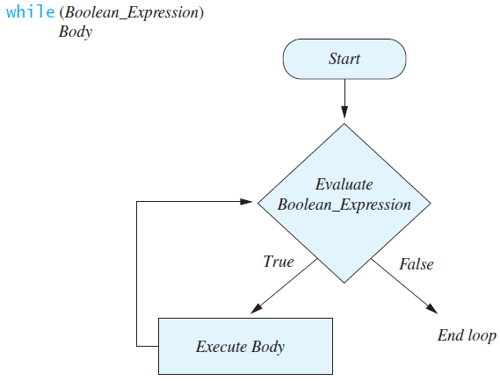
The while Statement
Figure 4.2
Semantics of the while statement

Slide 10
The do-while Statement
Also called a do-while loop
Similar to a while statement, except that the loop body is executed at least once
Syntax
  do
  Body_Statement
  while (Boolean_Expression);
Don’t forget the semicolon!

Slide 11
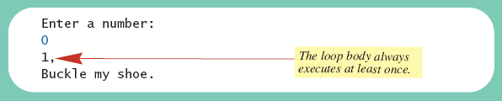
The do-while Statement
View sample program, listing 4.2
class DoWhileDemo
Sample
screen output

Slide 12
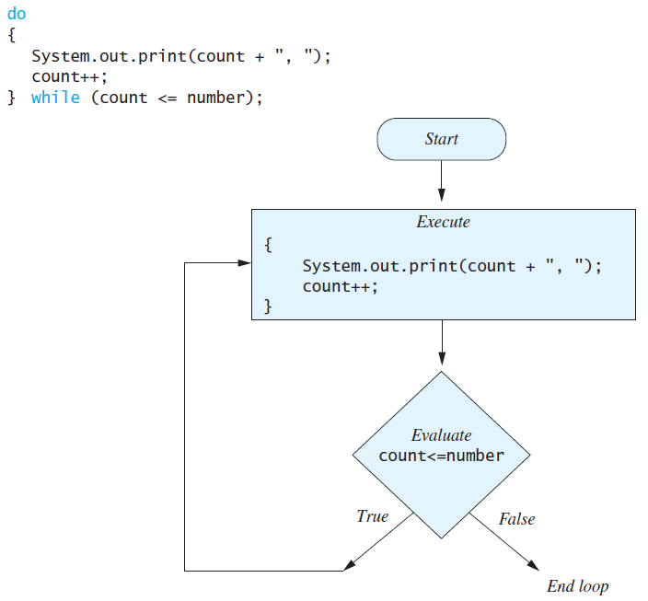
The do-while Statement
Figure 4.3 The Action of the do-while Loop in Listing 4.2

Slide 13
The do-while Statement
First, the loop body is executed.
Then the boolean expression is checked.
  As long as it is true, the loop is executed again.
  If it is false, the loop is exited.
Equivalent while statement
  Statement(s)_S1
  while (Boolean_Condition)
  Statement(s)_S1

Slide 14
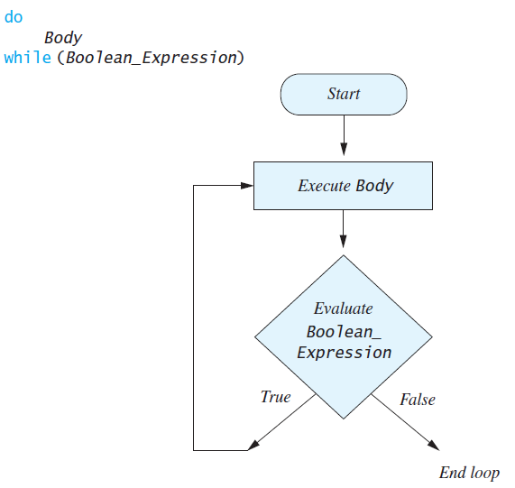
The do-while Statement
Figure 4.4 The Semantics of the
do-while Statement

Slide 15
Programming Example:
Bug Infestation
Given
  Volume a roach: 0.002 cubic feet
  Starting roach population
  Rate of increase: 95%/week
  Volume of a house
Find
  Number of weeks to exceed the capacity of the house
  Number and volume of roaches

Slide 16
Programming Example:
Bug Infestation
Algorithm for roach population program
(rough draft)
1. Get volume of house.
2. Get initial number of roaches in house.
3. Compute number of weeks until the house is full of roaches.
4. Display results.

Slide 17
Programming Example:
Bug Infestation
Variables Needed
GROWTH_RATE —weekly growth rate of the roach population (a constant 0.95)
ONE_BUG_VOLUME —volume of an average roach (a constant 0.002)
houseVolume — volume of the house
startPopulation —initial number of roaches
ctd. …

Slide 18
Programming Example:
Bug Infestation
Variables Needed
countWeeks —week counter
Population —current number of roaches
totalBugVolume —total volume of all the roaches
newBugs —number of roaches hatched this week
newBugVolume —volume of new roaches

Slide 19
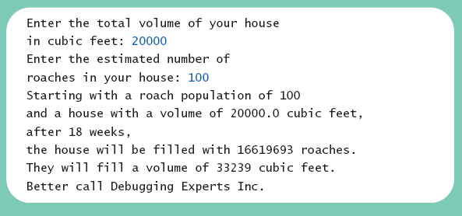
Programming Example:
Bug Infestation
View more detailed algorithm
View sample program, listing 4.3
class BugTrouble
Sample
screen output

Slide 20
Infinite Loops
A loop which repeats without ever ending is called an infinite loop.
If the controlling boolean expression never becomes false, a while loop or a do-while loop will repeat without ending.
A negative growth rate in the preceding problem causes totalBugVolume always to be less than houseVolume, so that the loop never ends.

Slide 21
Nested Loops
The body of a loop can contain any kind of statements, including another loop.
In the previous example
  The average score was computed using a while loop.
  This while loop was placed inside a do-while loop so the process could be repeated for other sets of exam scores.

Slide 22
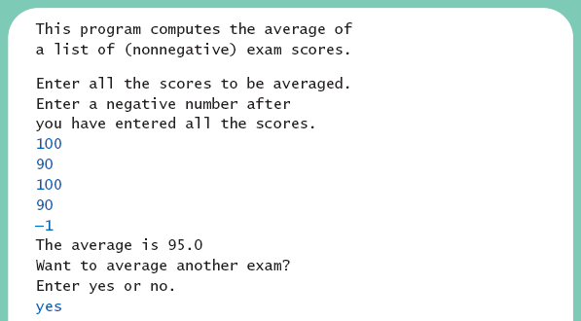
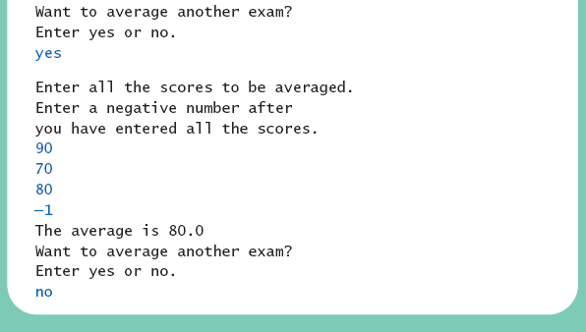
Nested Loops
View sample program, listing 4.4
class ExamAverager
Sample
screen output

Slide 23
The for Statement
A for statement executes the body of a loop a fixed number of times.
Example
  for (count = 1; count < 3; count++)
  System.out.println(count);

Slide 24
The for Statement
Syntax
  for (Initialization, Condition, Update)
  Body_Statement
Body_Statement can be either a simple statement or a compound statement in {}.
Corresponding while statement
  Initialization
  while (Condition)
  Body_Statement_Including_Update

Slide 25
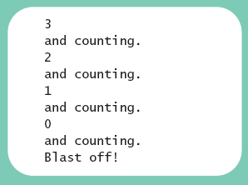
The for Statement
View sample program, Listing 4.4
class ForDemo
Sample
screen output

Slide 26
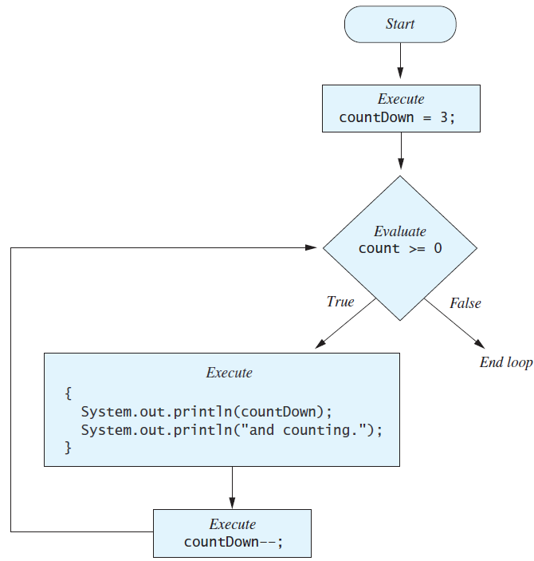
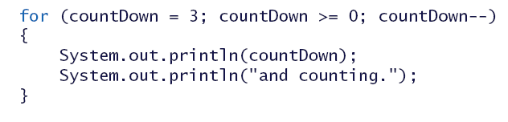
The for Statement
Figure 4.5 The action of the for loop in listing 4.5

Slide 27
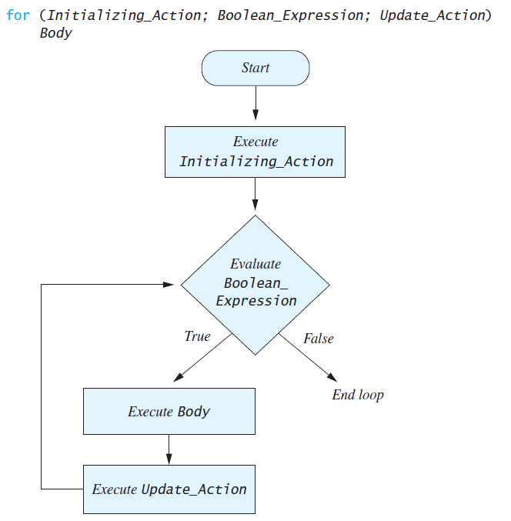
The for Statement
Figure 4.6 The semantics of the for statement

Slide 28
The for Statement
Possible to declare variables within a for statement
int sum = 0;
for (int n = 1 ; n <= 10 ; n++)
sum = sum + n * n;
Note that variable n is local to the loop

Slide 29
The for Statement
A comma separates multiple initializations
Example
  for (n = 1, product = 1; n <= 10; n++)
  product = product * n;
Only one boolean expression is allowed, but it can consist of &&s, ||s, and !s.
Multiple update actions are allowed, too.
  for (n = 1, product = 1; n <= 10;
  product = product * n, n++);

Slide 30
The for-each Statement
Possible to step through values of an enumeration type
Example
enum Suit {CLUBS, DIAMONDS, HEARTS, SPADES}
for (Suit nextSuit : Suit.values())
System.out.print(nextSuit + " ");
System.out.println();

Slide 31
Programming with Loops: Outline
The Loop Body
Initializing Statements
Controlling Loop Iterations
break and continue statements
Loop Bugs
Tracing Variables
Assertion checks

Slide 32
The Loop Body
To design the loop body, write out the actions the code must accomplish.
Then look for a repeated pattern.
  The pattern need not start with the first action.
  The repeated pattern will form the body of the loop.
  Some actions may need to be done after the pattern stops repeating.

Slide 33
Initializing Statements
Some variables need to have a value before the loop begins.
  Sometimes this is determined by what is supposed to happen after one loop iteration.
  Often variables have an initial value of zero or one, but not always.
Other variables get values only while the loop is iterating.

Slide 34
Controlling Number of Loop Iterations
If the number of iterations is known before the loop starts, the loop is called a count-controlled loop.
  Use a for loop.
Asking the user before each iteration if it is time to end the loop is called the ask-before-iterating technique.
  Appropriate for a small number of iterations
  Use a while loop or a do-while loop.

Slide 35
Controlling Number of Loop Iterations
For large input lists, a sentinel value can be used to signal the end of the list.
  The sentinel value must be different from all the other possible inputs.
  A negative number following a long list of nonnegative exam scores could be suitable.
  90
  0
  10
  -1

Slide 36
Controlling Number of Loop Iterations
Example - reading a list of scores followed by a sentinel value
  int next = keyboard.nextInt();
  while (next >= 0)
  {
  Process_The_Score
  next = keyboard.nextInt();
  }

Slide 37
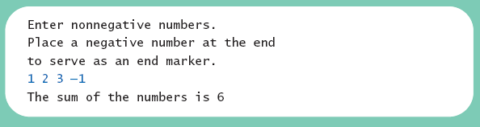
Controlling Number of Loop Iterations
Using a boolean variable to end the loop
View sample program, listing 4.6
class BooleanDemo
Sample
screen output

Slide 38
Programming Example
Spending Spree
  You have $100 to spend in a store
  Maximum 3 items
  Computer tracks spending and item count
  When item chosen, computer tells you whether or not you can buy it
Client wants adaptable program
  Able to change amount and maximum number of items
View sample algorithm

Slide 39
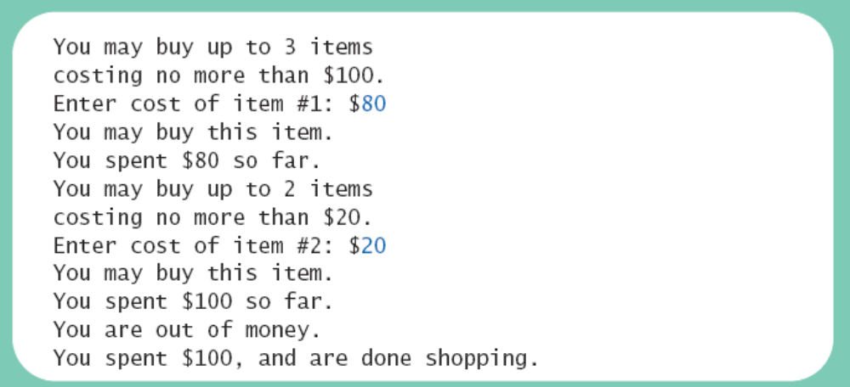
Programming Example
View sample program, listing 4.7
class SpendingSpree
Sample
screen output

Slide 40
The break Statement in Loops
A break statement can be used to end a loop immediately.
The break statement ends only the innermost loop or switch statement that contains the break statement.
break statements make loops more difficult to understand.
Use break statements sparingly (if ever).

Slide 41
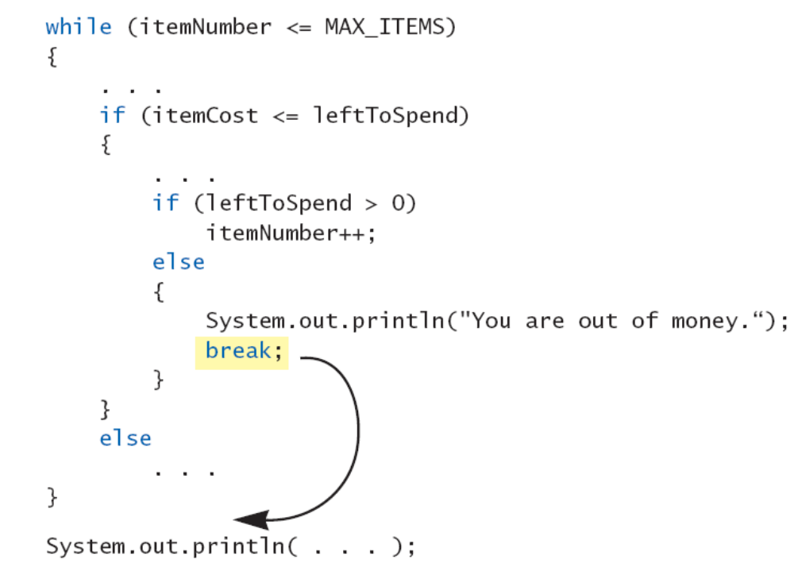
The break Statement in Loops
Note program fragment, ending a loop with a break statement,
listing 4.8

Slide 42
The continue Statement in Loops
A continue statement
  Ends current loop iteration
  Begins the next one
Text recommends avoiding use
  Introduce unneeded complications

Slide 43
Tracing Variables
Tracing variables means watching the variables change while the program is running.
  Simply insert temporary output statements in your program to print of the values of variables of interest
  Or, learn to use the debugging facility that may be provided by your system.

Slide 44
Assertion Checks
Assertion : something that says something about the state of the program
  Can be true or false
  Should be true when no mistakes in running program

Slide 45
Assertion Checks
Example found in comments
//n == 1
while (n < limit)
{
n = 2 * n;
}
//n >= limit
//n is the smallest power of 2 >= limit
Syntax for assertion check
Assert Boolean_Expression;

Slide 46
Assertion Checks
Equivalent example using assert
assert n == 1;
while (n < limit)
{
n = 2 * n;
}
assert n >= limit;
//n is the smallest power of 2 >= limit.

Slide 47
Loop Bugs
Common loop bugs
  Unintended infinite loops
  Off-by-one errors
  Testing equality of floating-point numbers
Subtle infinite loops
  The loop may terminate for some input values, but not for others.
  For example, you can’t get out of debt when the monthly penalty exceeds the monthly payment.

Slide 48
Programming Example
A multiface Applet
  Uses loop to draw several smiley faces
  Uses if statement to alter appearance
View sample program, listing 4.9
class MultipleFaces

Slide 49
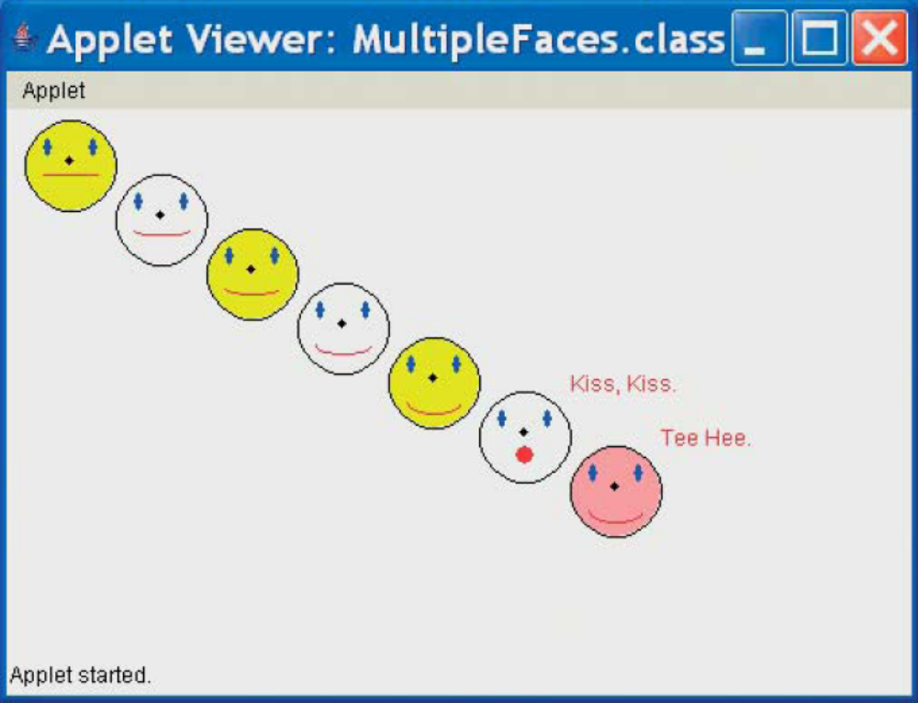
Programming Example
Sample
screen output

Slide 50
The drawString Method
Similar to methods for drawing ovals
Displays text
Example
canvas.drawString("Hello",10, 20);
  Writes word Hello at point (10, 20)
Used to place "Kiss, Kiss" and
"Tee Hee" on screen in listing 4.9

Slide 51
Summary
A loop is a programming construct that repeats an action
Java has the while, the do-while, and the for statements
The while and do-while repeat the loop while a condition is true
The logic of a for statement is identical to the while

Slide 52
Summary
Loops may be ended using a sentinel value or a boolean value
Typical loop bugs include infinite loops or loops which are off by 1 iteration
Variables may be traced by including temporary output statements or a debugging utility
The assert statement can be used to check conditions at run time
Use drawString to display text in an applet

